Slide 1
s
e
c
o
n
d
C
O
R
N
A
N
I
T
H
I
S
13.1-14
A free CD of this message will be available following the service
It will also be available for podcast later this week at calvaryokc.com

Slide 2
Aristophanes coined term korinthiazomai to refer to fornication
O
A
N
S
13.1-14
I
I
s
e
c
o
n
d
C
R
N
T
H

Slide 3
O
A
N
S
13.1-14
I
I
s
e
c
o
n
d
C
R
N
T
H

Slide 4
1 Cor. 3.3^{b}-4 - ^{3b} For where there are envy, strife, and divisions among you, are you not carnal and behaving like mere men? ⁴ For when one says, “I am of Paul,” and another, “I am of Apollos,” are you not carnal?
O
A
N
S
13.1-14
I
I
s
e
c
o
n
d
C
R
N
T
H

Slide 5
1 Cor. 5.1 - It is actually reported that there is sexual immorality among you,
and such sexual immorality as is not even named among the Gentiles — that a man has his father's wife!
O
A
N
S
13.1-14
I
I
s
e
c
o
n
d
C
R
N
T
H

Slide 6
1 Cor. 6.1 - Dare any of you, having a matter against another, go to law before the unrighteous, and not before the saints?
O
A
N
S
13.1-14
I
I
s
e
c
o
n
d
C
R
N
T
H

Slide 7
1 Cor. 7:10-11 - ¹⁰ Now to the married I command, yet not I but the Lord: A wife is not to depart from her husband. ¹¹ But even if she does depart, let her remain unmarried or be reconciled to her husband. And a husband is not to divorce his wife.
O
A
N
S
13.1-14
I
I
s
e
c
o
n
d
C
R
N
T
H

Slide 8
1 Cor. 10.14 - Therefore, my beloved, flee from idolatry.
1 Cor. 11.20-21 - ²⁰ Therefore when you come together in one place, it is not to eat the Lord's Supper. ²¹ For in eating, each one takes his own supper ahead of others; and one is hungry and another is drunk.
O
A
N
S
13.1-14
I
I
s
e
c
o
n
d
C
R
N
T
H

Slide 9
1 Cor. 14.18, 23 - ¹⁸ I thank my God I speak with tongues more than you all;
²³ Therefore if the whole church comes together in one place, and all speak with tongues, and there come in those who are uninformed or unbelievers, will they not say that you are out of your mind?
O
A
N
S
13.1-14
I
I
s
e
c
o
n
d
C
R
N
T
H

Slide 10
O
A
N
S
13.1-14
I
I
s
e
c
o
n
d
C
R
N
T
H

Slide 11
1 Cor. 2:9-10ª - ⁹ But as it is written:
“Eye has not seen, nor ear heard,
Nor have entered into the heart of man
The things which God has prepared for those who love Him.”
^{10a} But God has revealed them to us through His Spirit.
O
A
N
S
13.1-14
I
I
s
e
c
o
n
d
C
R
N
T
H

Slide 12
O
A
N
S
13.1-14
I
I
s
e
c
o
n
d
C
R
N
T
H

Slide 13
Matt. 18.20 - For where two or three are gathered together in My name, I am there in the midst of them.
O
A
N
S
13.1-14
I
I
s
e
c
o
n
d
C
R
N
T
H

Slide 14
O
A
N
S
13.1-14
I
I
s
e
c
o
n
d
C
R
N
T
H

Slide 15
Living Bible - ² I have already warned those who had been sinning when I was there on my second visit. Now I again warn them and all others, just as I did before, that this next time I will not spare them. ³ I will give you all the proof you want that Christ speaks through me. Christ is not weak in his dealings with you; he is a mighty power among you.
O
A
N
S
13.1-14
I
I
s
e
c
o
n
d
C
R
N
T
H

Slide 16
O
A
N
S
13.1-14
I
I
s
e
c
o
n
d
C
R
N
T
H

Slide 17
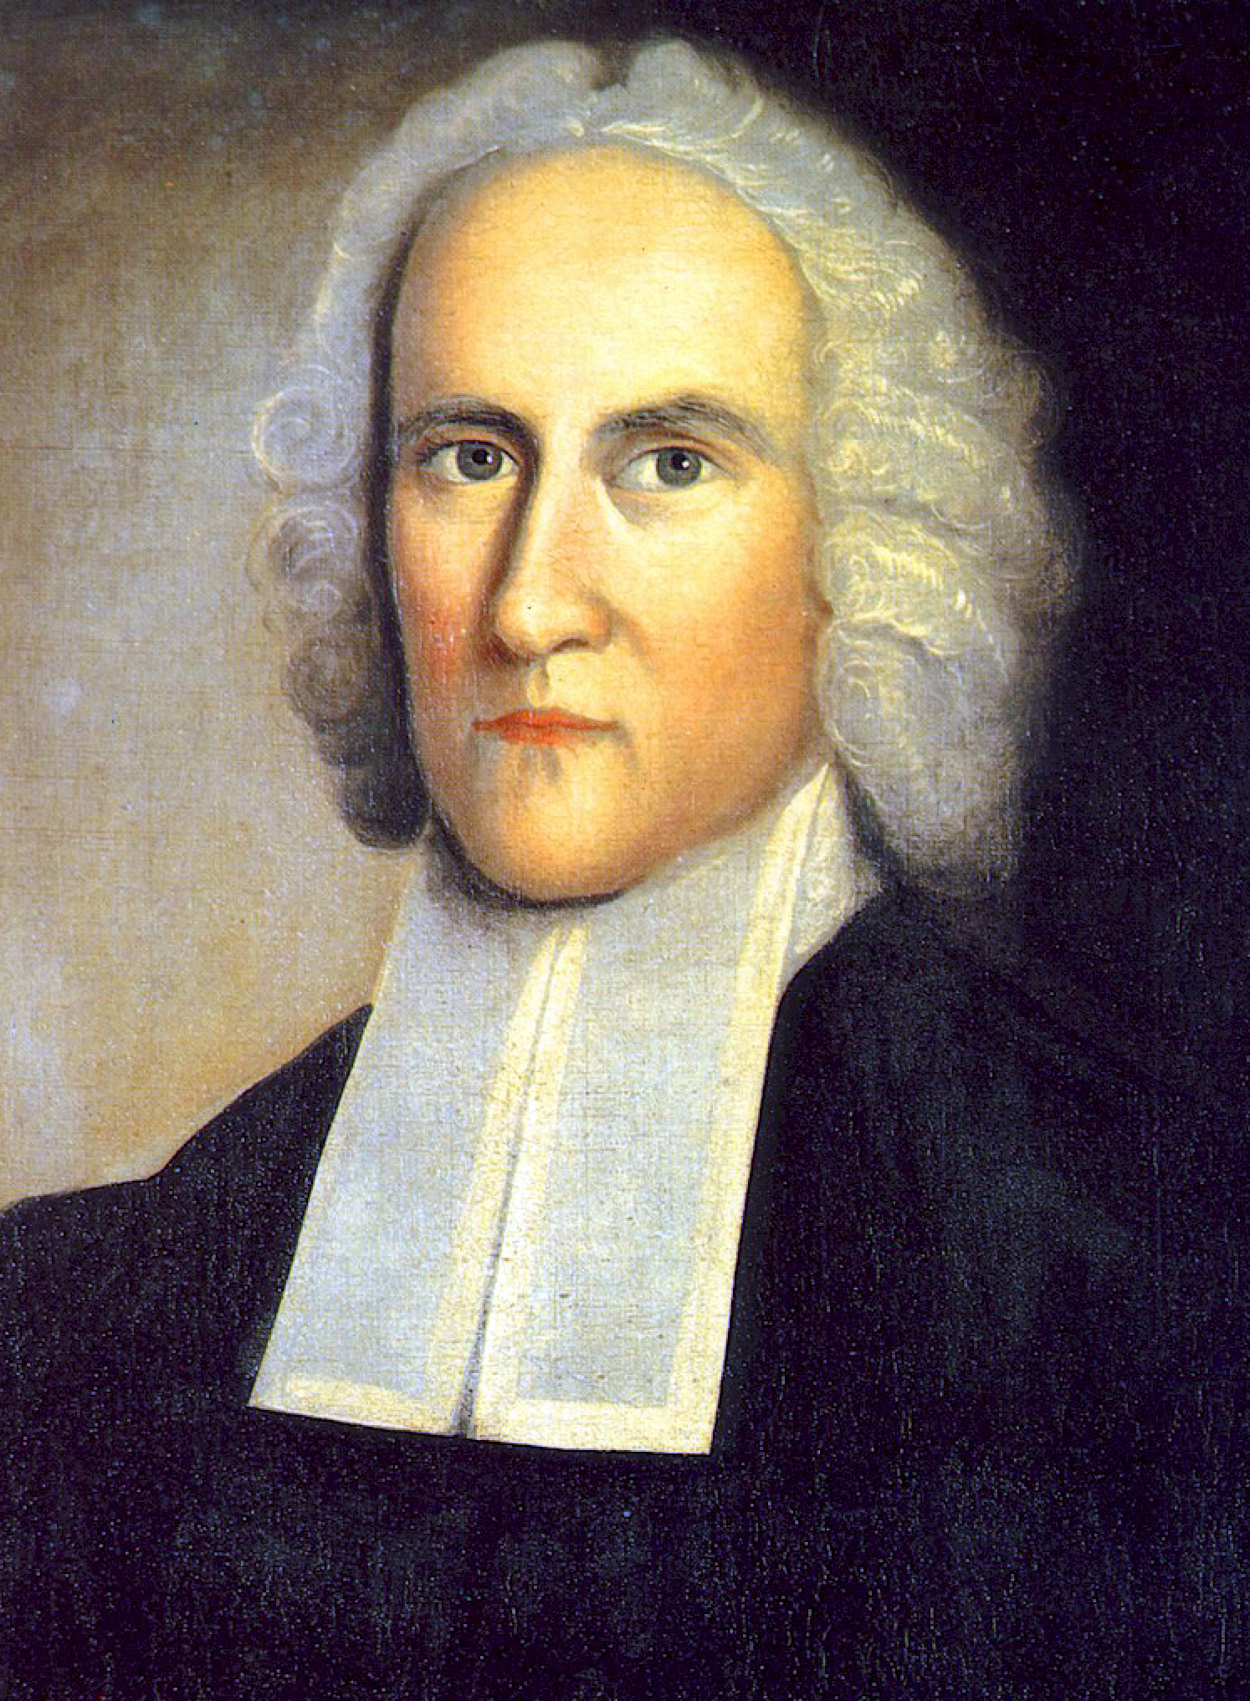
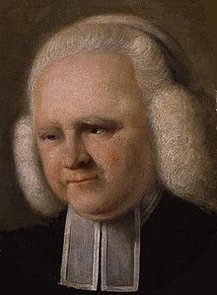
2 Cor. 10.10: “For his letters,” they say, “are weighty and powerful, but his bodily presence is weak, and his speech contemptible.”
Jonathan Edwards
(1703-1758)
George Whitefield
(1714-1770
O
A
N
S
13.1-14
I
I
s
e
c
o
n
d
C
R
N
T
H

Slide 18
O
A
N
S
13.1-14
I
I
s
e
c
o
n
d
C
R
N
T
H

Slide 19
Phillips - You should be looking at yourselves to make sure that you are really Christ's. It is yourselves that you should be testing, not me. You ought to know by this time that Christ is in you, unless you are not real Christians at all.
O
A
N
S
13.1-14
I
I
s
e
c
o
n
d
C
R
N
T
H

Slide 20
O
A
N
S
13.1-14
I
I
s
e
c
o
n
d
C
R
N
T
H

Slide 21
Approved - dokimos
Disqualified - adokimos
O
A
N
S
13.1-14
I
I
s
e
c
o
n
d
C
R
N
T
H

Slide 22
O
A
N
S
13.1-14
I
I
s
e
c
o
n
d
C
R
N
T
H

Slide 23
Complete - to be made ready, to be fitted
Mark 1.19 - When He had gone a little farther from there, He saw James the son of Zebedee, and John his brother, who also were in the boat mending their nets.
O
A
N
S
13.1-14
I
I
s
e
c
o
n
d
C
R
N
T
H

Slide 24
O
A
N
S
13.1-14
I
I
s
e
c
o
n
d
C
R
N
T
H

Slide 25
2 Pet. 3:15^{b}-16ª – ^{15a} …our beloved brother Paul, according to the wisdom given to him, has written to you, ^{16a} as also in all his epistles, speaking in them of these things, in which are some things hard to understand, which untaught and unstable people twist to their own destruction, as they do also the rest of the Scriptures.
O
A
N
S
13.1-14
I
I
s
e
c
o
n
d
C
R
N
T
H

Slide 26
Jam. 2:20 - But do you want to know, O foolish man, that faith without works is dead?
Jam. 2:24 - You see then that a man is justified by works, and not by faith only.
Prov. 24:7ª - For as he thinks in his heart, so is he.
O
A
N
S
13.1-14
I
I
s
e
c
o
n
d
C
R
N
T
H

Slide 27
ESV - ⁶ Do not eat the food of a stingy man,
do not crave his delicacies;
⁷ for he is the kind of man
who is always thinking about the cost.
“Eat and drink,” he says to you,
but his heart is not with you.
O
A
N
S
13.1-14
I
I
s
e
c
o
n
d
C
R
N
T
H

Slide 28
“Judith Christ of Nazareth, The Gospels of the Bible, Corrected to Reflect that Christ Was a Woman, Extracted from Matthew, Mark, Luke and John,”
O
A
N
S
13.1-14
I
I
s
e
c
o
n
d
C
R
N
T
H

Slide 29
O
A
N
S
13.1-14
I
I
s
e
c
o
n
d
C
R
N
T
H

Slide 30
ESV - Aim for restoration
O
A
N
S
13.1-14
I
I
s
e
c
o
n
d
C
R
N
T
H

Slide 31
O
A
N
S
13.1-14
I
I
s
e
c
o
n
d
C
R
N
T
H

Slide 32
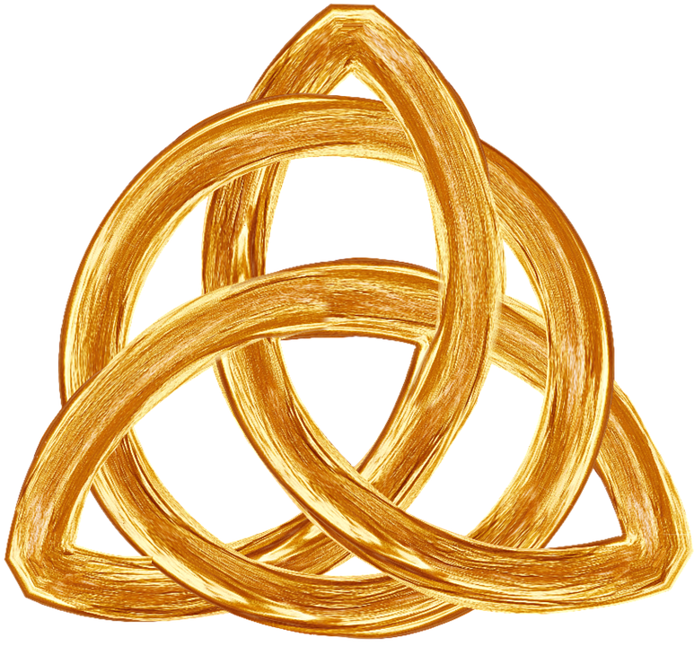
Father
spirit
Son
O
A
N
S
13.1-14
I
I
s
e
c
o
n
d
C
R
N
T
H

Slide 33
O
A
N
S
13.1-14
I
I
s
e
c
o
n
d
C
R
N
T
H

